Slide 1

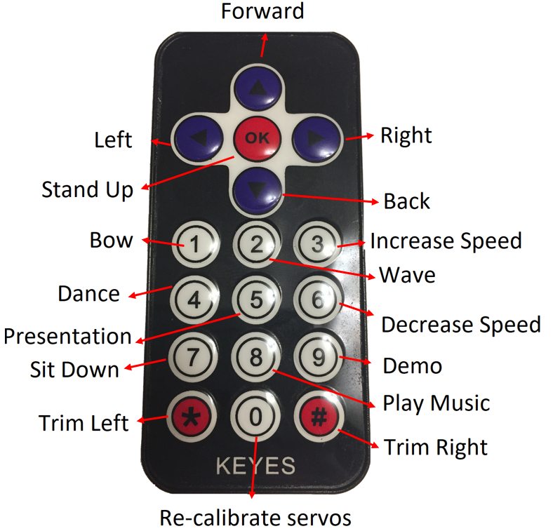
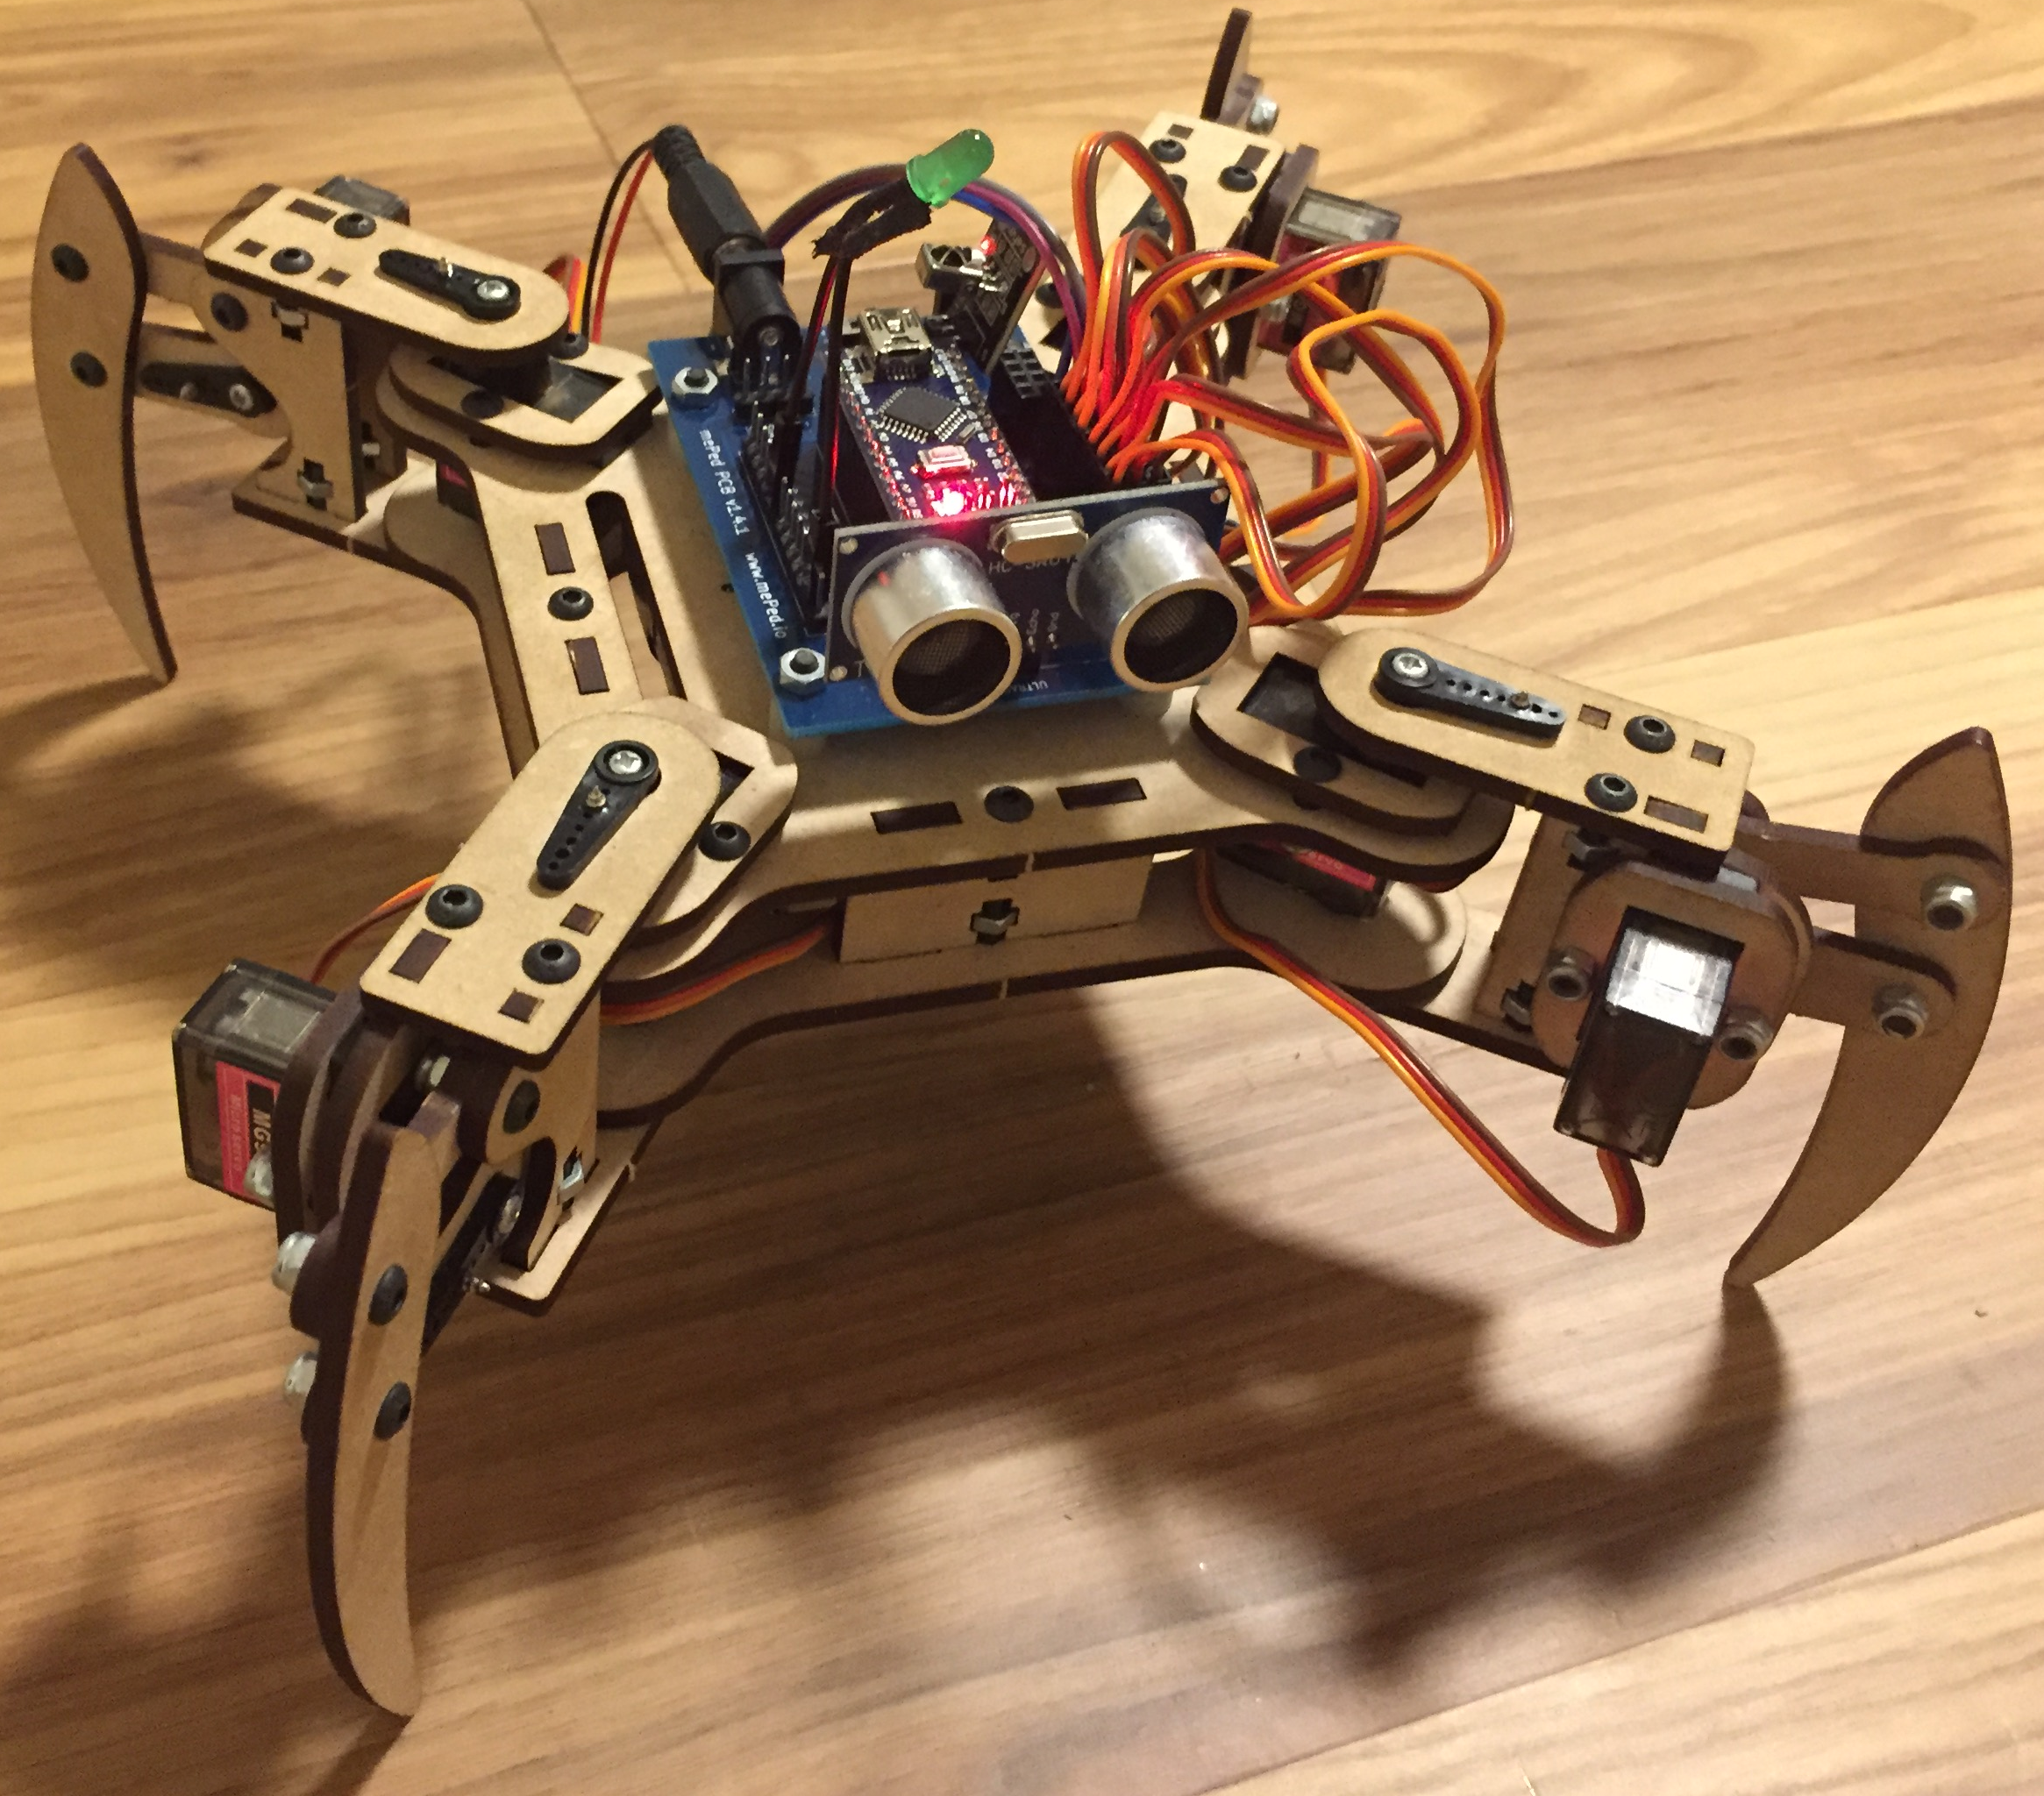
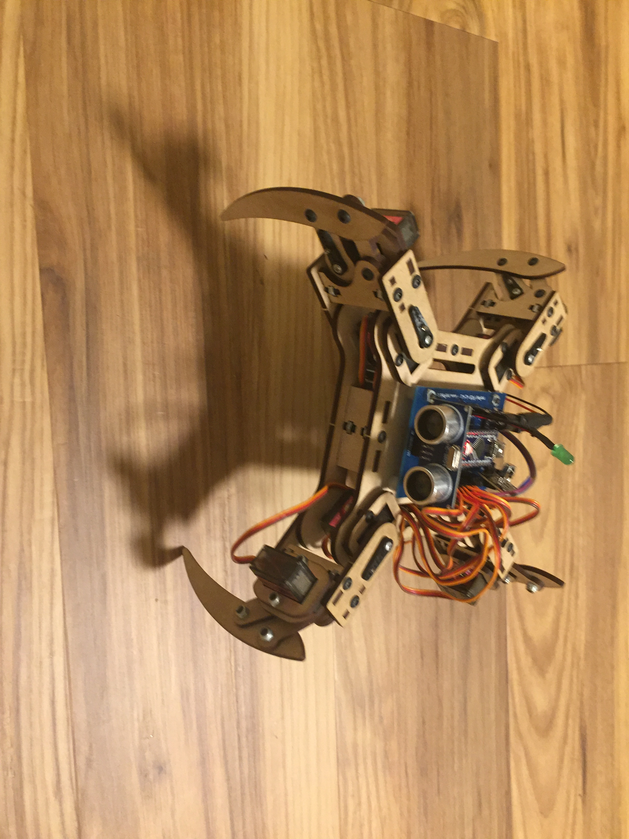
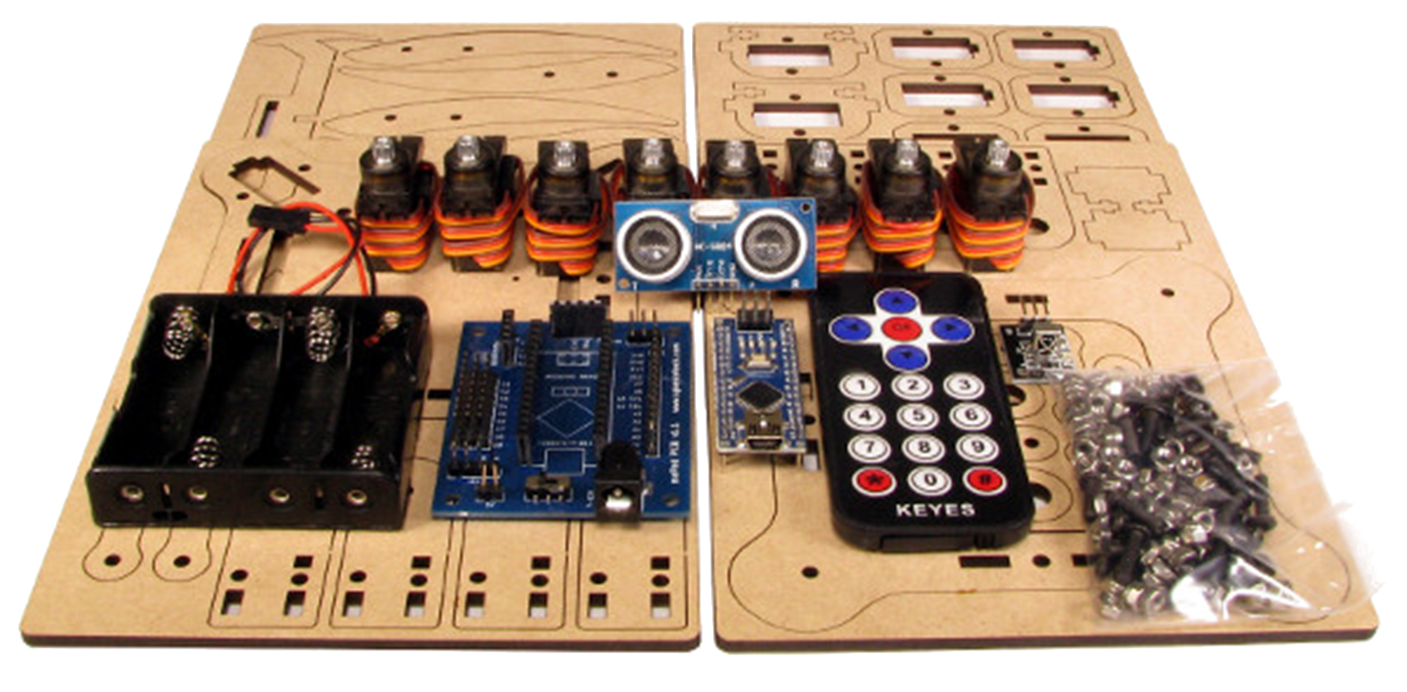
Pars
Rafael Laya
Shoreline Community College - ENGR102
INTRODUCTION
MATERIALS AND METHODS
MATERIALS AND METHODS (CONT.)
CONCLUSIONS
Pars is a walking and dancing robot that has been developed with open source software and hardware.
Pars is based on Spierce Technology’s walking robot mePed V2 (version 2).
The core of Pars is the small yet powerful Arduino Nano microcontroller and eight servos that allow Pars to move freely as commanded by an Infrared Remote Control.
Spierce Technology’s mePed V2.0 Complete Kit:
Body Wood Kit.
Eight (8) MG90S micro-servo.
One (1) Ultrasonic sensor.
One (1) Infrared Remote Control.
One (1) Arduino Nano Microcontroller.
Forty (40) M3 x 10mm Screws.
The power of open source software and hardware make it possible for the rookie engineers to build circuitry that is controlled via a microcontroller such as the Arduino that makes it possible to complete useful projects at low costs while providing a great learning experience.
The method consisted on adding more functionality to mePed V2.0 by improving already developed behavior and adding more complex behavior such as dancing or playing music (see usage) through programming functions and the use of input received via an ultrasonic sensor.
The method most used during the programming was the abstraction of functionality that serve as building blocks for more complex functionality.
Usage
Forty (40) M3 x 10mm Screws.
Sixteen (16) M3 x 16mm Screws.
Twenty-eight (28) M3 Hex Nuts.
Thirty-two (32) M3 Nyloc Hex Nuts.
Four (4) Circuit Board Spacers.
One (1) mePed Circuit Board.
One (1) Infrared Sensor.
One (1) AA Battery Holder.
One (1) color LED.
One (1) Passive Buzzer.
Four (4) AA Batteries.
Wire.
Optional soldering supplies.
OBJECTIVES
To demonstrate the power of open source software and hardware.
To show the strength of the DYI (Do it Yourself) method to build circuitry and combine logic that completes specific and useful tasks successfully at low costs while providing a great learning experience.
To build a walking and dancing robot that is fun to play.
To learn about the basics of mechatronics and programming.
RESULTS
BACKGROUND
Mechatronics is the field of engineering that combines mechanics and electronics.
Open source software/hardware means some piece of software/hardware is made available online and the author allows some distribution according to an specific license.
This is a project for an introduction to electronics engineering class.
References
http://www.meped.io/mepedv2
https://www.arduino.cc/
https://www.posterpresentations.com/
Contact
Email: Alfonzo.laya@go.shoreline.edu

